Slide 1




Public Information
PDF Information
Talent Information

Slide 2
Example: Contractor Investigation – Southern Ontario Market
2016 Q2 ––––––––––––––––––––––––––––– 2021 Q2
Top 5 Market Players
Wins
Total Bid
Winning %
Maple Reinders
43
70
62%
Kenaidan Contracting Ltd
29
64
45%
HDR Corp
24
55
44%
ROMAG Contracting Ltd
13
31
42%
Kingdom Construction Ltd
21
71
38%

Slide 3
Example: Contractor Investigation – Southern Ontario Market
2016 Q2 ––––––––––––––––––––––––––––– 2021 Q2
Top 5 Market
Players
Winning Rate($%)
Wins / Bids
Maple Reinders
31%
$111.5M / $364.0M
ROMAG Contracting Ltd
35%
$90.6M / $261.7M
Kenaidan Contracting Ltd
8%
$32.1M / $399.0M
H.I.R.A Ltd.​
14%
$15.9M / $109.6M
Kingdom Construction Ltd
16%
$13.1M / $80.6M

Slide 4
Example: Contractor Investigation – Kingdom Construction Ltd
2016 Q2 ––––––––––––––––––––––––––––– 2021 Q2
Bids: 47 Projects
Wins: 6 Projects / $13.1M
13
12
10
8
4
3
3
0
0
0
York Region
Halton Region
Waterloo Region
City of Guelph
Others

Slide 5
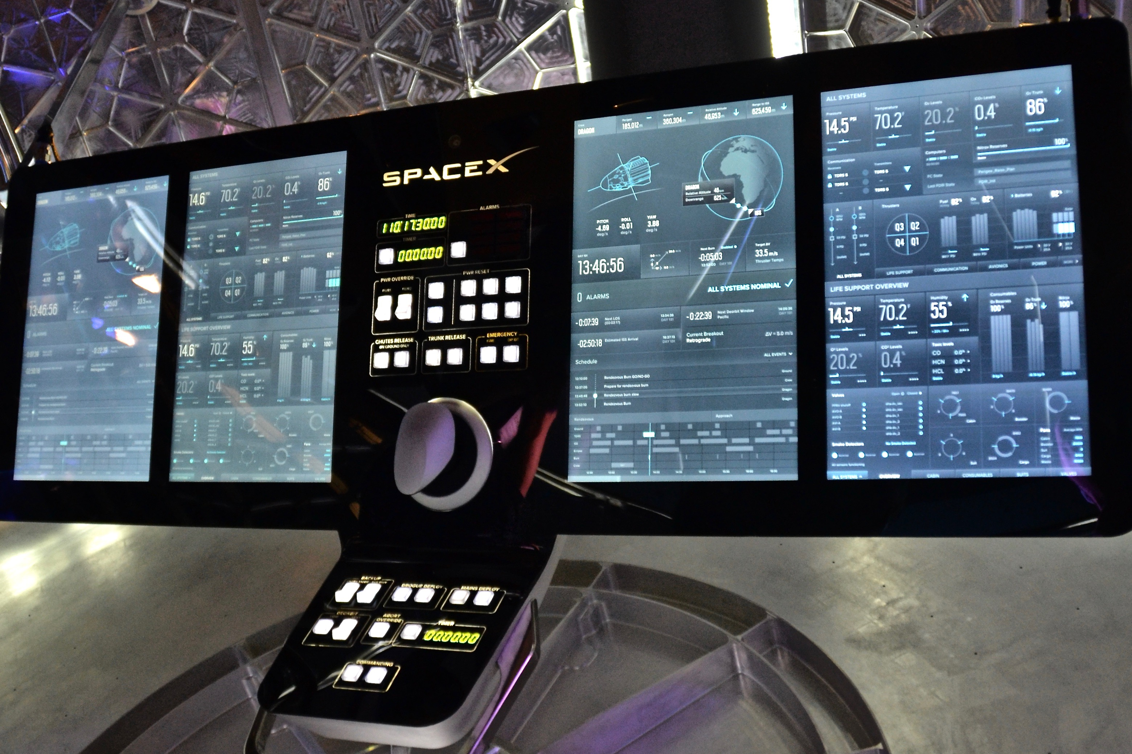

Slide 6
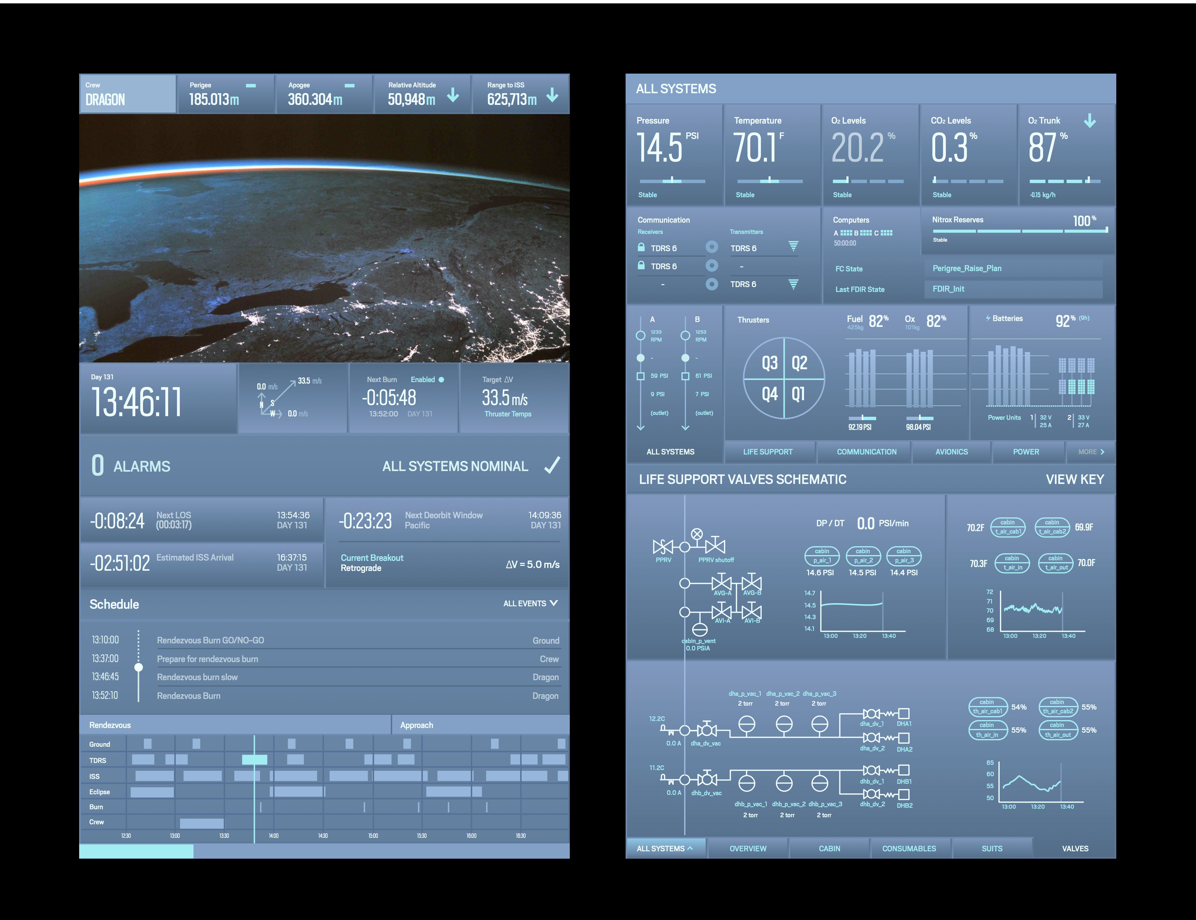

Slide 7
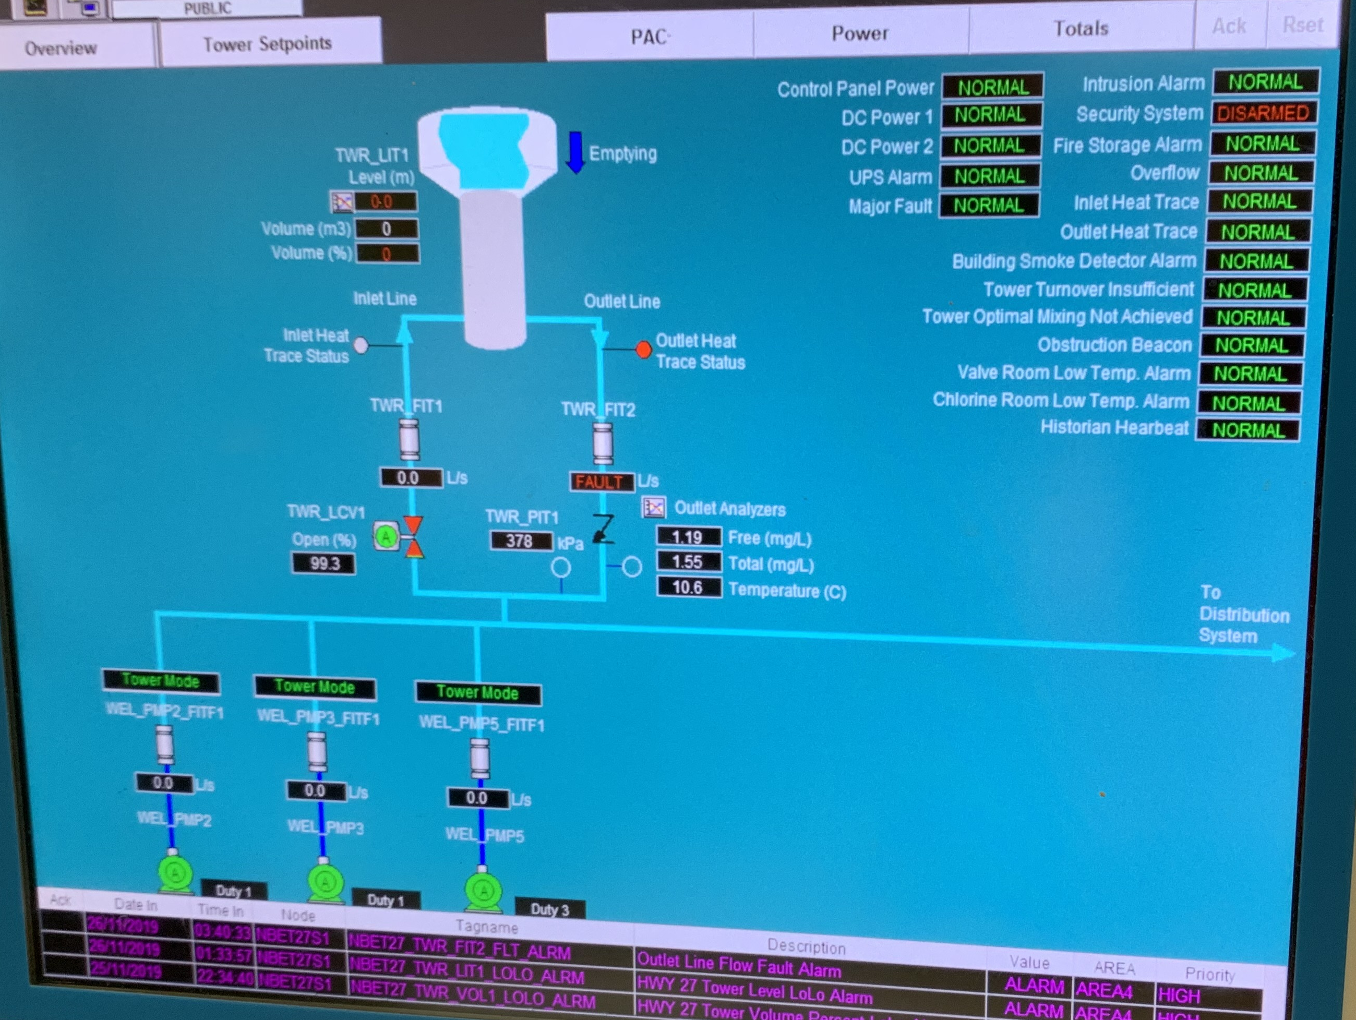

Slide 9
Example: Niagara Region Engineering Consulting Market
2018 Q3 ––––––––––––––––––––––––––––– 2021 Q2
234 Engineering Consulting Projects
103
75
35
21
2018
2019
2020
2021

Slide 10
Example: Niagara Region Engineering Consulting Market
Top 4 Market Players
Wins
Total Bid
Winning %
Associated Engineering
16
37
43%
WSP
16
58
28%
CIMA
13
32
41%
Wood Canada Limited
13
33
39%

Slide 11
Example: Niagara Region Engineering Consulting Market
Market “New” Player: Wood Canada Limited
19 Bids, Wining 53%
13 Bids, Wining 31%
3 Bids, No Wining
2018
2019
2020

Slide 12
Example: Niagara Region Engineering Consulting Market
Market “New” Player: Wood Canada Limited’s Talent
No Talents
Wood Canada Limited
Niagara Region
4 Talents

Slide 13
Example: GM BluePlan Engineering Limited in Southern Ontario
2017 Q1 ––––––––––––––––––––––––––––– 2021 Q4
Bids: 295 Projects
Wins: 114 Projects (38.6%)
80
70
63
54
28
31
30
23
22
8
2017
2018
2019
2020
2021

Slide 14
Example: GM BluePlan Engineering Limited in City of Guelph
2017 Q1 ––––––––––––––––––––––––––––– 2021 Q4
Bids: 38 Projects
Wins: 20 Projects (52.6%)
9
11c
11c
6
5
3
4
3
3
2017
2018
2019
2020
2021

Slide 15
Asset Health Concern
Asset Name
Asset ID
Asset Photo ID
Asset Repair Year 1
Asset Repair Year 2
Asset Capital Project 1
Asset Remaining Service life
Asset Replacement Year
Asset Location
Asset Material
Asset Observation 2
Asset Observation 1
Asset Capital Project 2
Asset Prob. Of Failure
Asset Type
Asset Capital Project 3
Asset Risk
Asset Observation 3
Asset Expected Life
Asset Replacement Cost
Asset Condition Comments
Asset Age
Asset Code Concern
Asset Repair Strategy 1
Asset Repair Strategy 2
Asset Condition

Slide 16
Systematic Approach
Basic Info
Analysis Info
Planning Info
Asset Name
Asset Type
Asset Repair Year 1
Asset ID
Asset Material
Asset Repair Year 2
Asset Observations
Asset Condition Comments
Asset Code Concern
Asset Repair Strategy 1
Asset Installation Year
Asset Repair Strategy 2
Asset Photo ID
Asset Health Concern
Asset Location
Asset Remaining Service life
Asset Capital Project 1
Asset Replacement Cost
Asset Age
Asset Capital Project 2
Asset Condition
Asset Capital Project 3
Asset Expected Life
Asset Replacement Year
Asset Prob. Of Failure

Slide 17
Systematic Approach
Basic Info
Analysis Info
Planning Info
Asset Type
Asset Repair Year 1
Asset Material
Asset Repair Year 2
Asset Condition Comments
Asset Code Concern
Asset Repair Strategy 1
Asset Health Concern
Asset Repair Strategy 2
Asset Remaining Service life
Asset Capital Project 1
Asset Age
Asset Capital Project 2
Asset Condition
Asset Capital Project 3
Asset Expected Life
Asset Replacement Year
Asset Prob. Of Failure
Asset Risk

Slide 18
Systematic Approach
Basic Info
Analysis Info
Planning Info
Asset Name
Asset Type
Asset Repair Year 1
Asset ID
Asset Material
Asset Repair Year 2
Asset Observations
Asset Condition Comments
Asset Code Concern
Asset Repair Strategy 1
Asset Installation Year
Asset Repair Strategy 2
Asset Photo ID
Asset Health Concern
Asset Location
Asset Remaining Service life
Asset Capital Project 1
Asset Replacement Cost
Asset Age
Asset Capital Project 2
Asset Condition
Asset Capital Project 3
Asset Expected Life
Asset Replacement Year
Asset Prob. Of Failure
Asset Risk

Slide 19

Systematic Approach
Basic Info
Analysis Info
Planning Info
Asset Name
Asset Type
Asset Repair Year 1
Asset ID
Asset Material
Asset Repair Year 2
Asset Observations
Asset Condition Comments
Asset Code Concern
Asset Repair Strategy 1
Asset Installation Year
Asset Repair Strategy 2
Asset Photo ID
Asset Health Concern
Asset Location
Asset Remaining Service life
Asset Capital Project 1
Asset Replacement Cost
Asset Age
Asset Capital Project 2
Asset Condition
Asset Capital Project 3
Asset Expected Life
Asset Replacement Year
Asset Prob. Of Failure
Asset Risk

